Slide 1

JAVA Full Stack Development Course Counseling Video
GIRI’S TECH HUB PVT.LTD- PUNE – IT Training & Placement Company
Contact: 9175444433 , 9049361265
Website: http://www.techhubindia.org

Slide 2
1
Objective Of This Course
Preparing Students For Placement and Industry Ready Resource .
2
Prerequisite Qualification
Engineering(Any Branch),MCA,MCS,Msc,BCA/BCS
3
Outcomes of this Course
Can Join As Java Backend Developer
Can Join As Frontend Developer
Can Join As Full stack Developer
Can Join As Node developer
Can Join As SAP Fury Developer etc

Slide 3
01
DS And C Language
OOP using C++
05
ADV JAVA
(JDBC,Servlet,JSP)
02
06
Core JAVA
Advance JavaScript
and React JS
Course Content Details
03
07
Spring – core, DAO,ORM,MVC,AOP
Hibernate & Spring Boot
SQL/PLSQL
(database)
04
HTML/CSS
/Bootstrap/JS
08
Communication Skill & Aptitude Training with HR Interview Preparation

Slide 4
01
Initial 4.5 Months Daily 7 hours training
Conduct Test & Mock interview twice in month on Saturday and Sunday
02
Training & Placement Planning
300+ hours pre recorded video sessions and 4000+ pages notes for preparation and 1000+ interview question bank
03
Add on Sessions for Project Guidance and Industry Required Tools like as GIT, JIRA, DOCKER etc
04

Slide 5



GIRI’S Tech Hub PVT.LTD Profile
15
3000+
300
15 years of Experience
In Technical Training
More than 3000+ learners Placed As Software Developers
300+ Workshops & 200+ batches Completed in Class Room & online Training

Slide 6
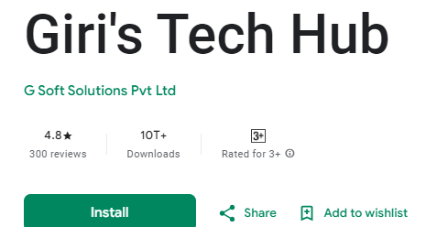
For Your Reference
https://techhubindia.org/
website
Android App
Placement Record
https://techhubindia.org/Placement

Slide 7





Thank You!
www.techhubindia.org

